Slide 1
R Programming
Debugging Tools
Basic Tools

Slide 2
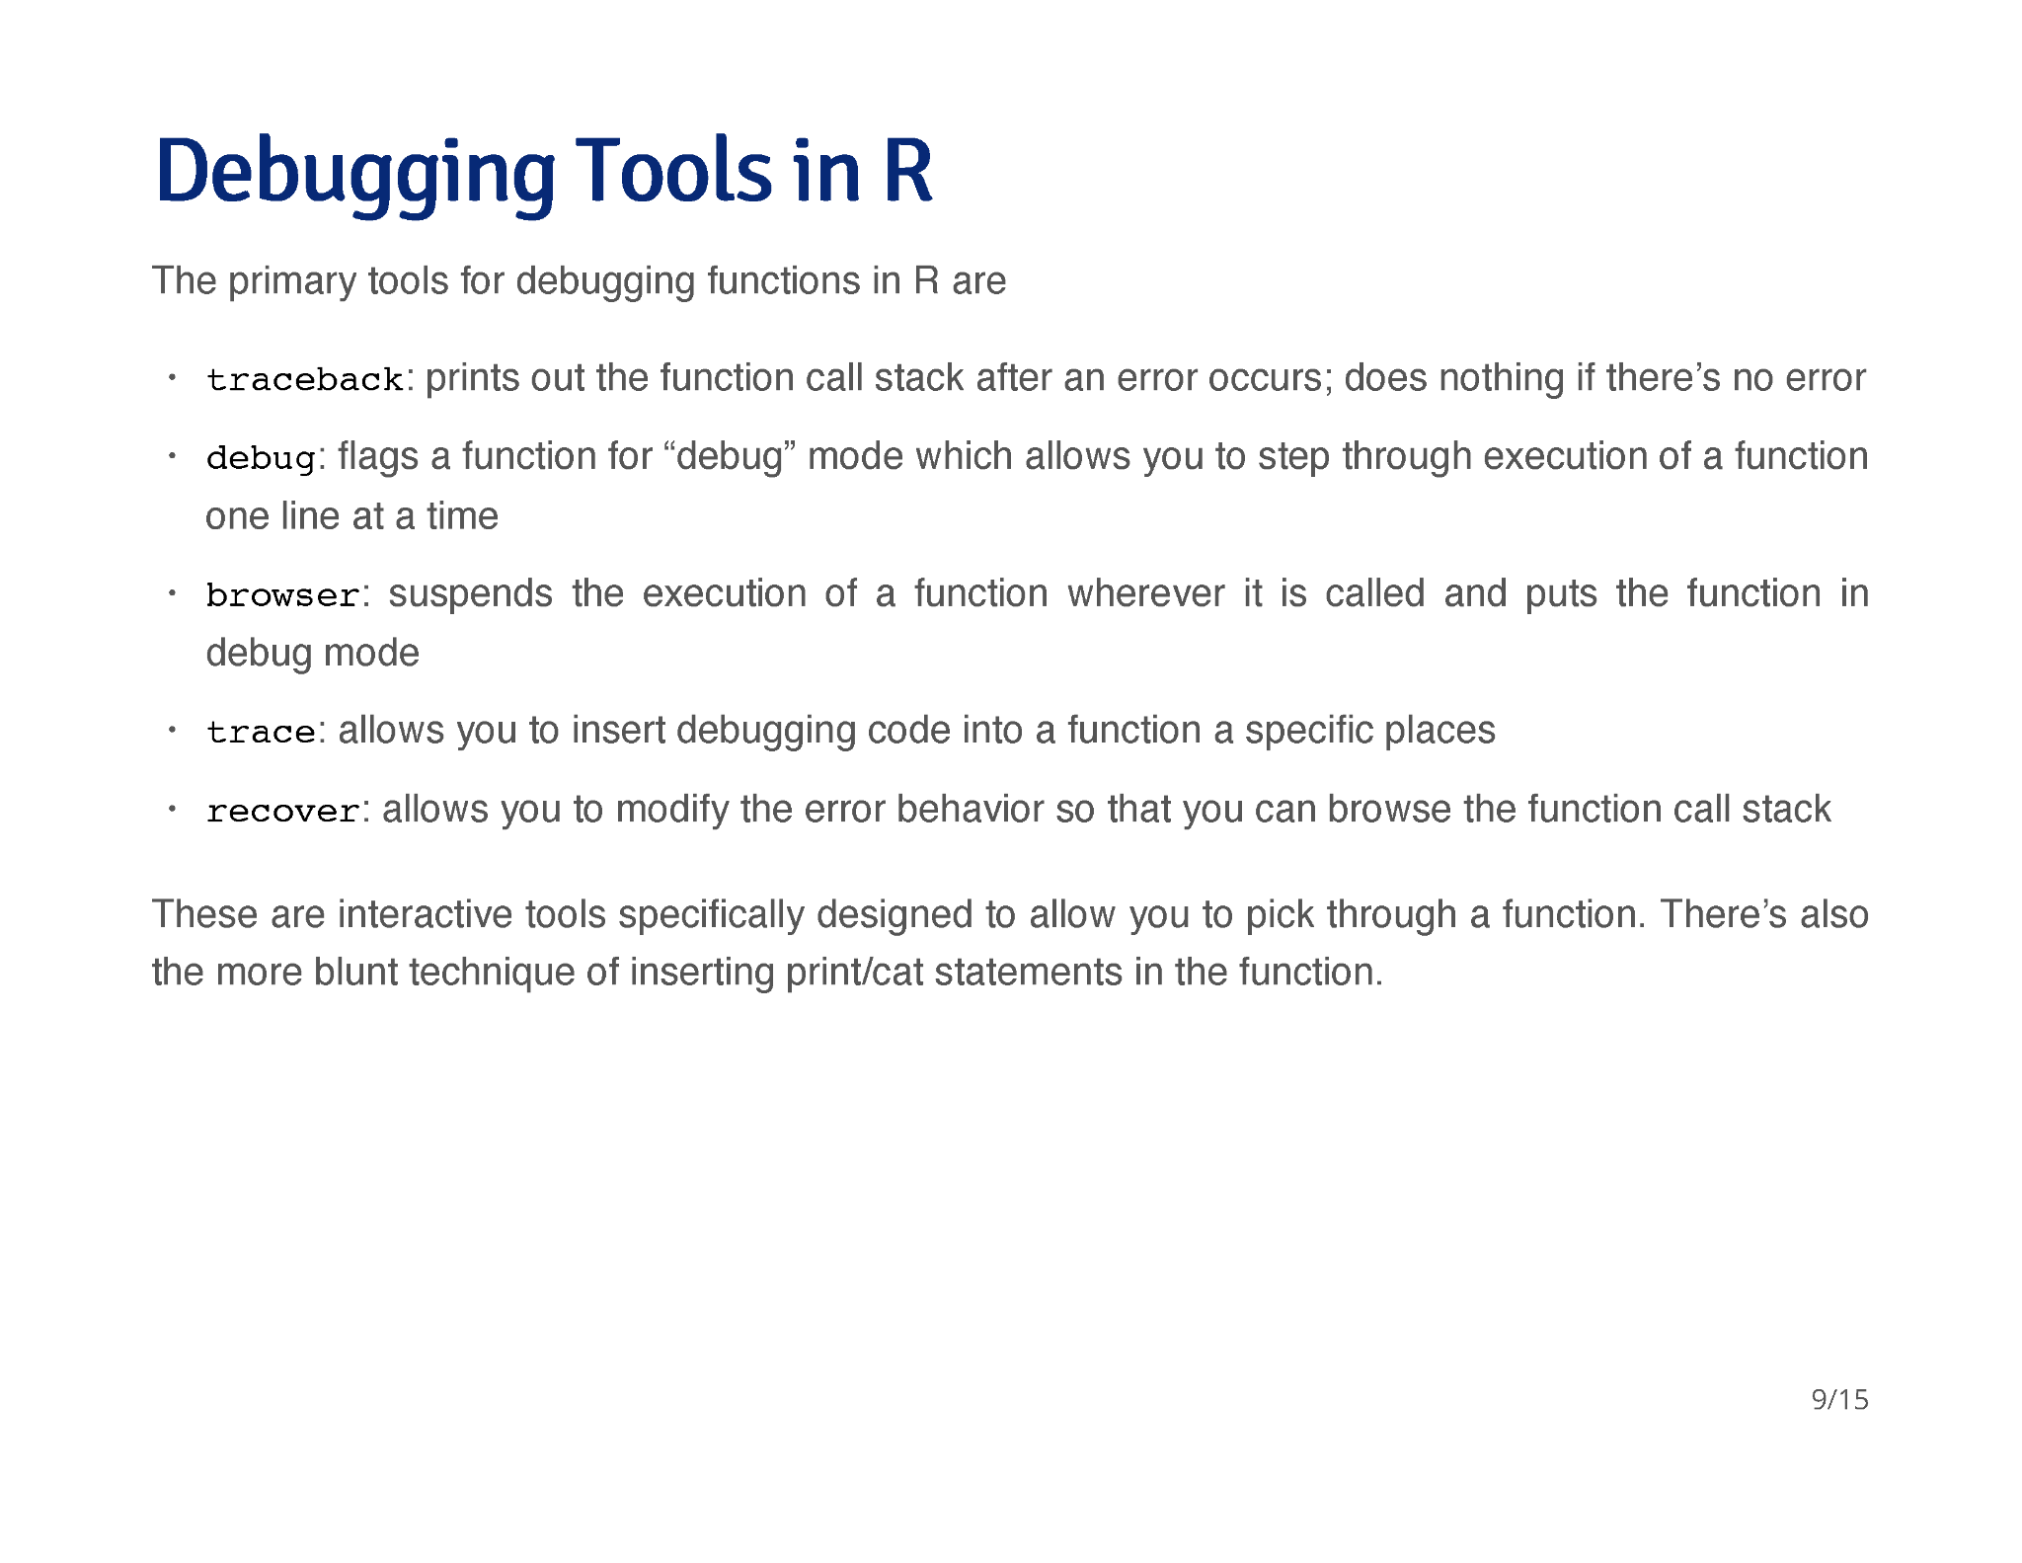

Slide 3
R Programming
Debugging Tools
Using the Tools

Slide 4
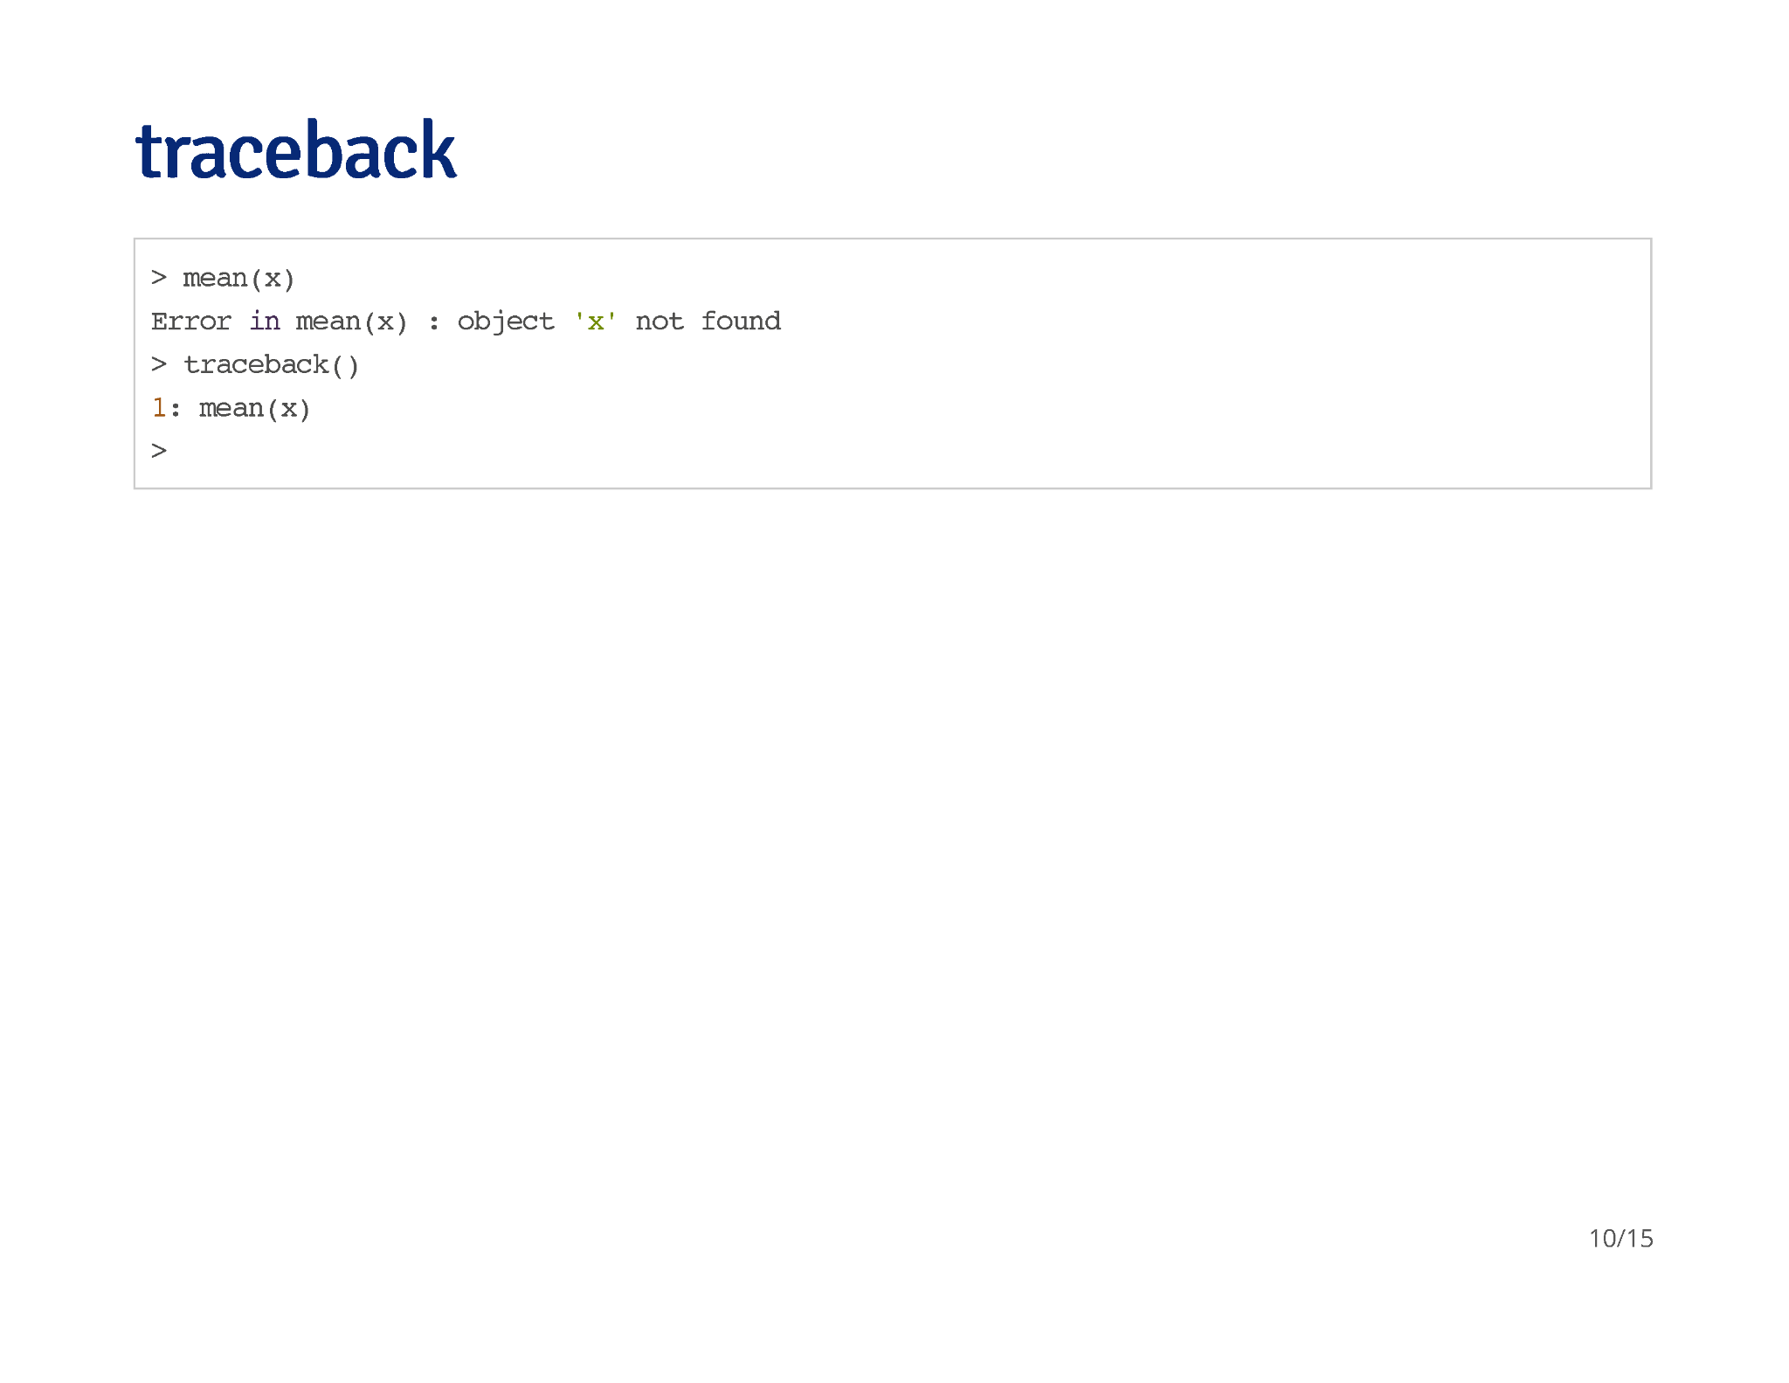

Slide 5
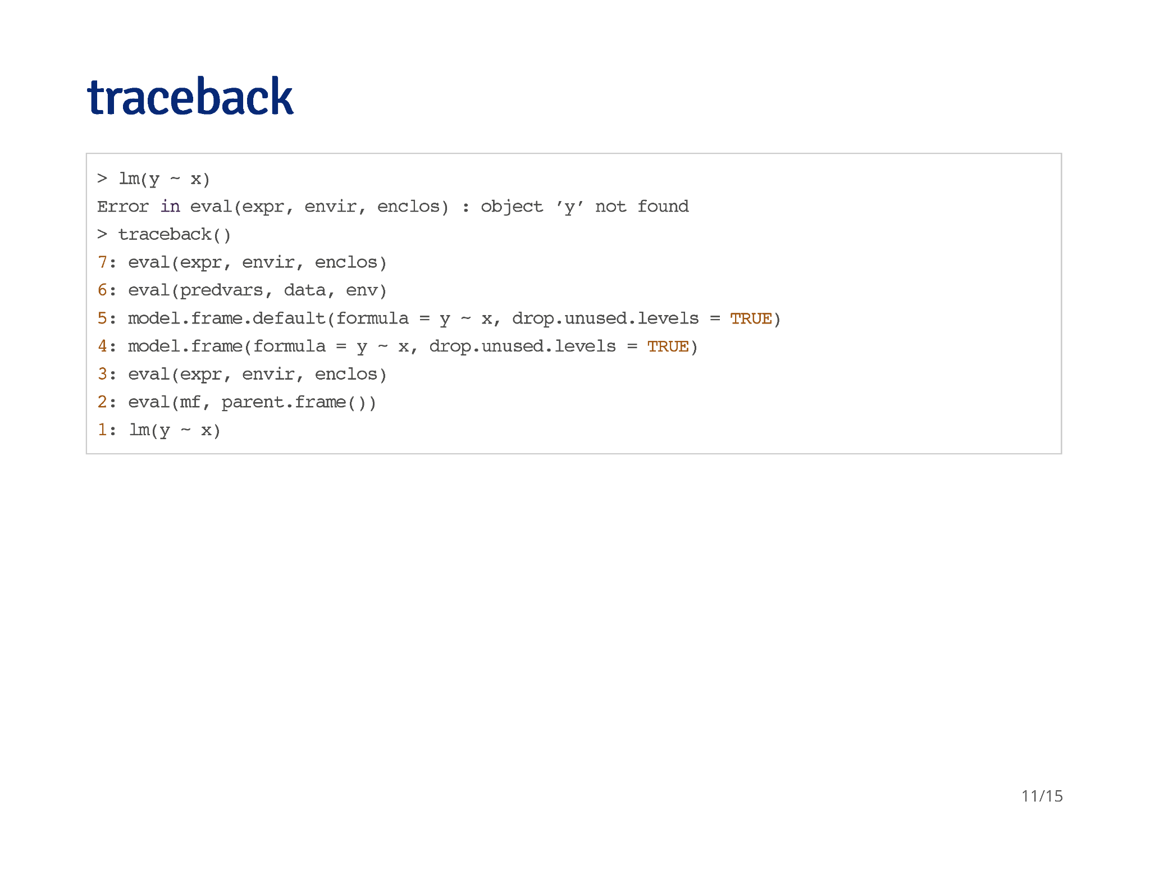

Slide 6
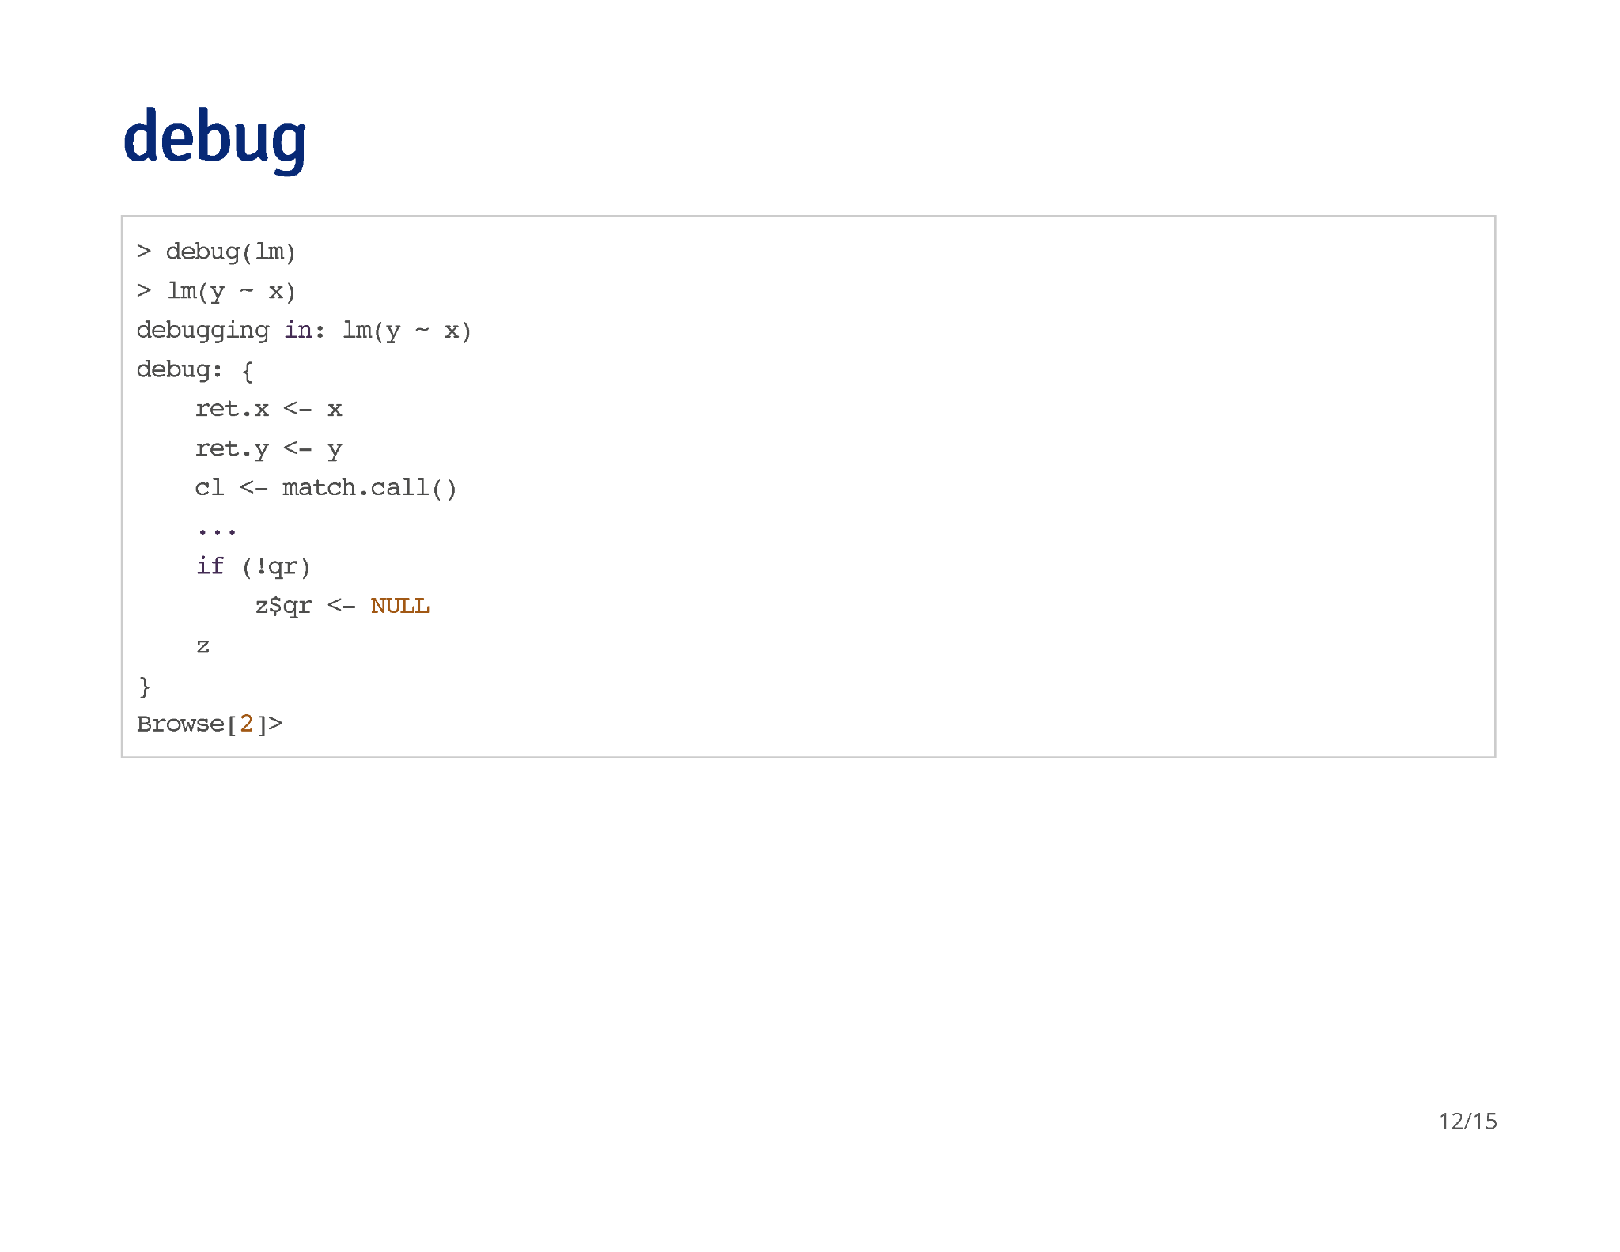

Slide 7
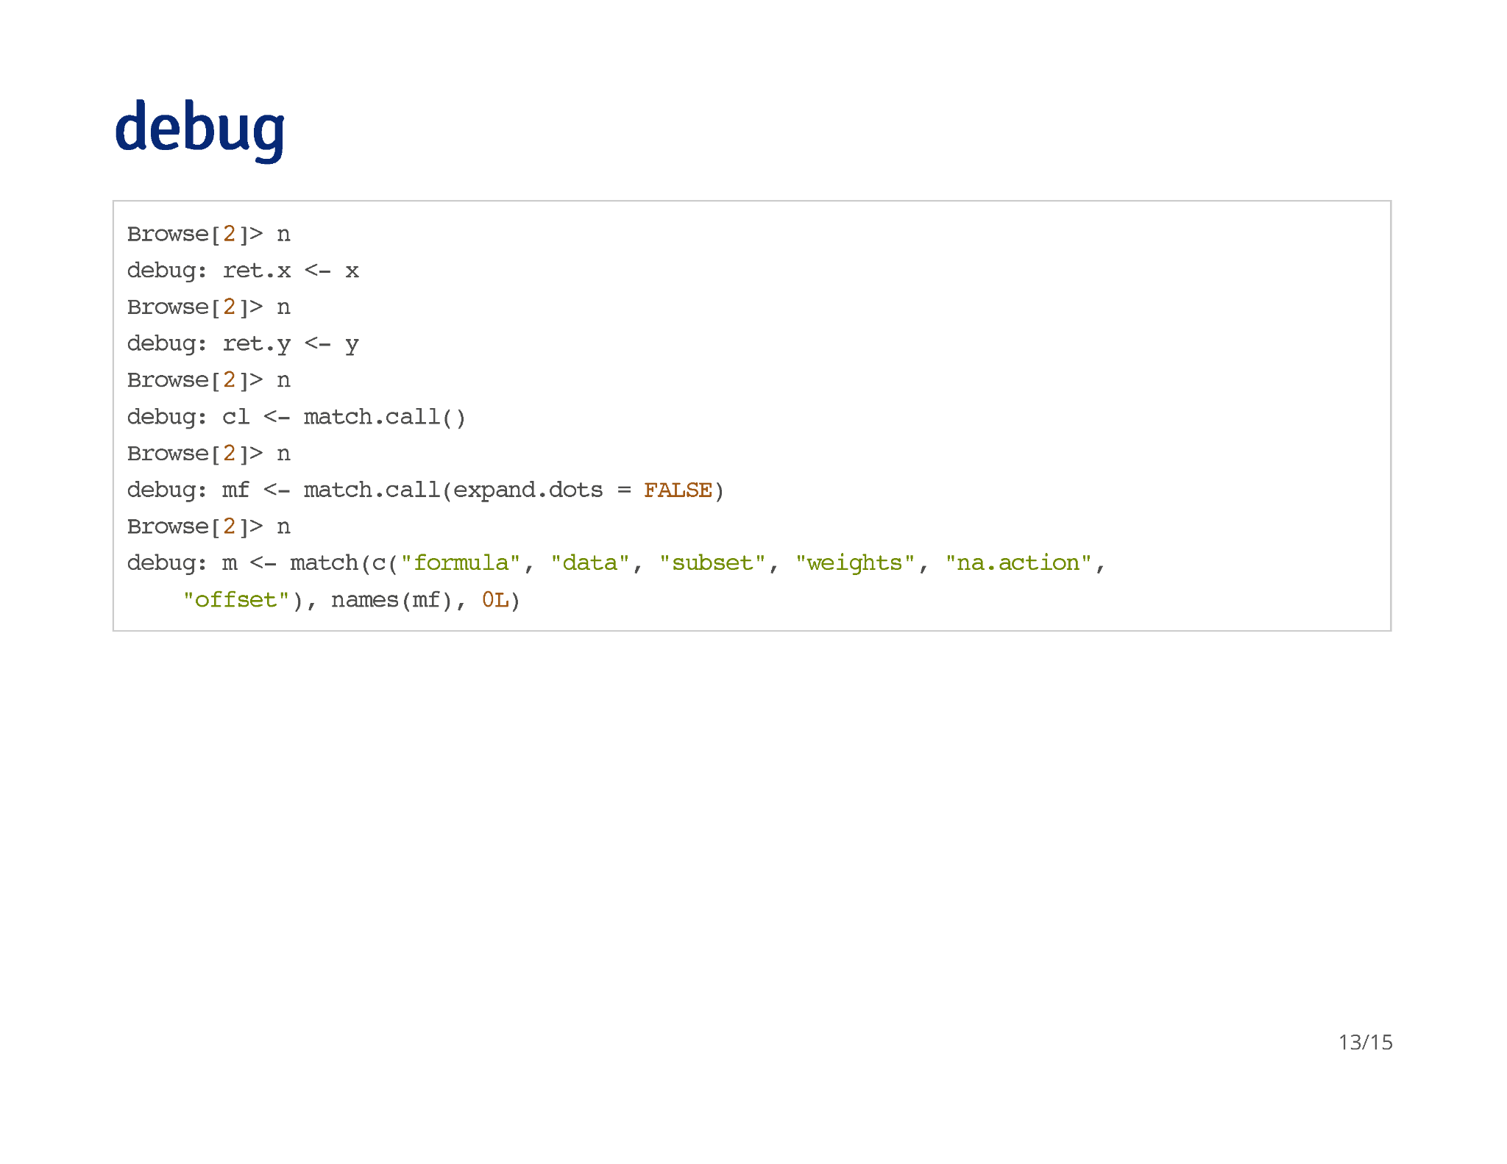

Slide 8
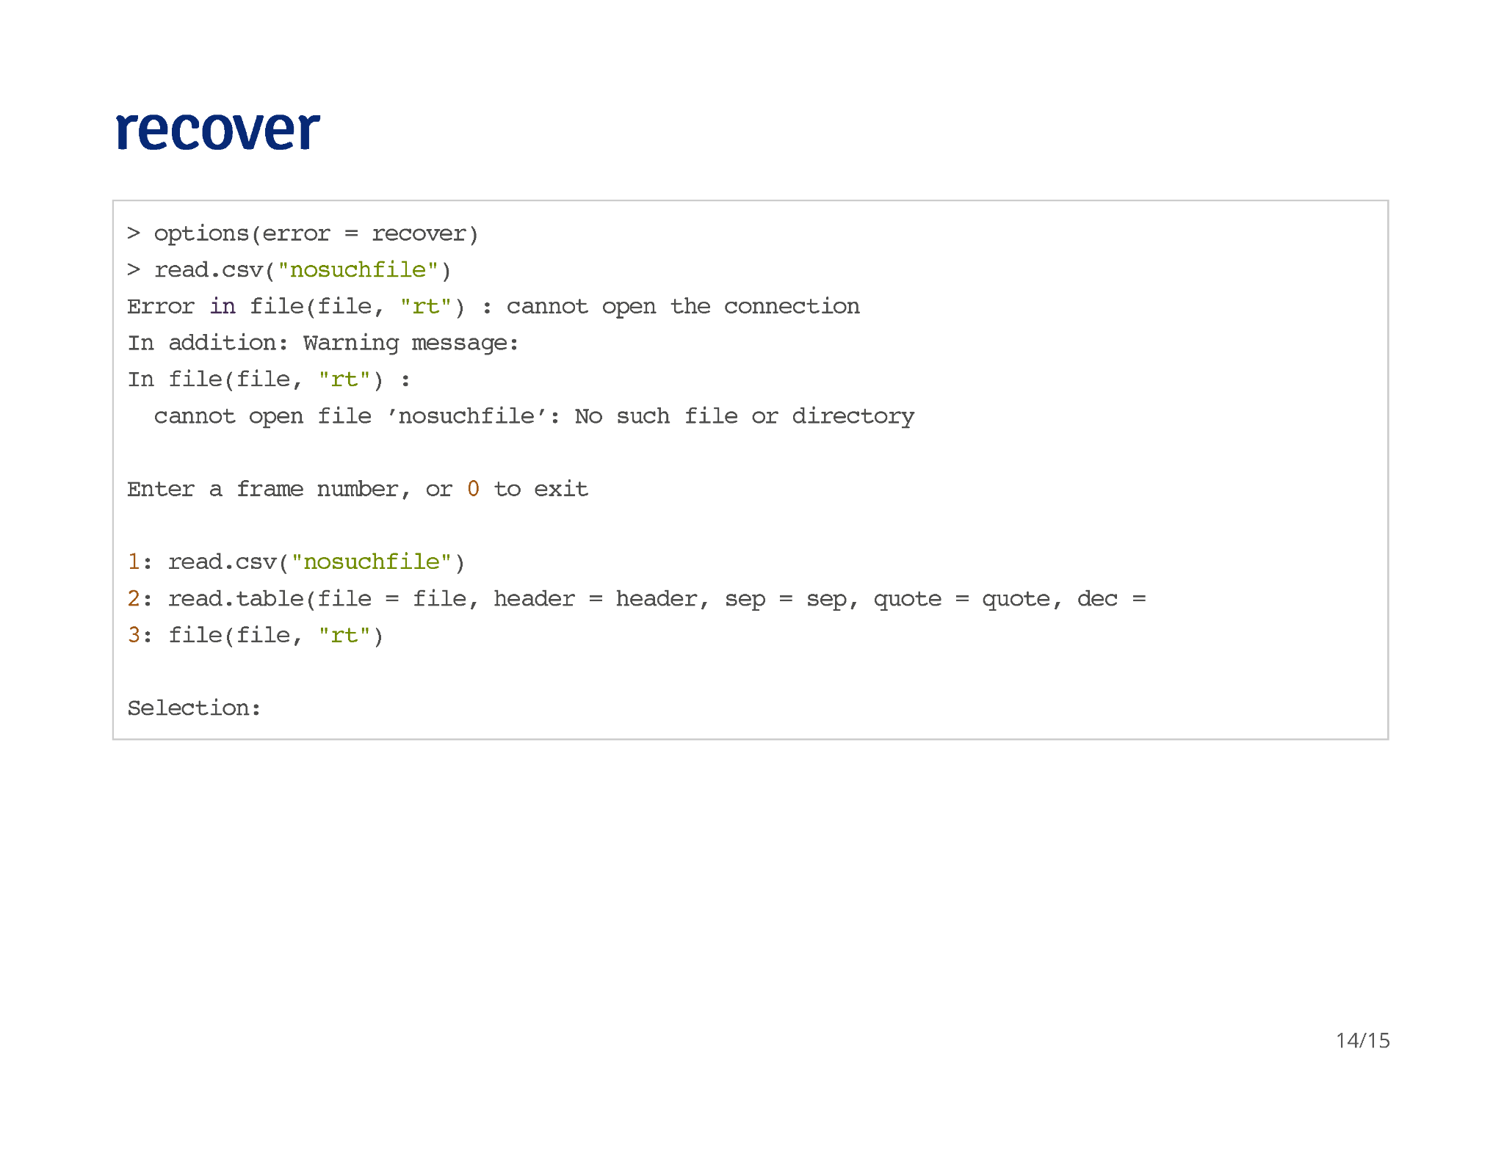

Slide 9
